Slide 1
Intro to Music notation software
Music Notation programs
Benefiting you and your students

Slide 2
Why do I need to learn a music notation program?
Whether you are a composer or not, having a functional knowledge of a one or more of these programs will prepare you as an educator to:
Create warm-ups, drills, and exercises designed specifically for your group.
Replace *missing parts. Temporarily.
Teaching your students (beginning) composition/arranging.
Write out a part that is lost or missing from the original set.
Create an outlet for student and personal creativity.
Keep up with technology. It is faster than hand writing music.

Slide 3
What to use and why
Musescore – IT IS FREE! Great in getting students started.
Sibelius and Finale – Standard programs that are extensive. $$
Garage Band – Fun for students to experiment with, does not require a music background. Comes with apple products, can be upgraded to pro level.
Dorico – Nice Interface and frequently updated. $$

Slide 4
What can my students write music for?
Band/Orchestra/Choir
Solo or Chamber group
Movies/Film
Jazz
Dance/Ballet
Video Games
Marching or Pep Band
Commercials (Jingles)
Television
Rock, Pop, Country, Rap, Hip-Hop, Metal, etc.
For FUN!
CAN YOU THINK OF MORE?

Slide 5
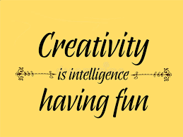
Remember
Students are creative and want outlets to explore their creativity.
There are no age restrictions to writing music. Mozart, Prokofiev, Chopin, Boulanger, Paganini, and many more wrote music before they were 10.
Students don’t have to know how to play an instrument learn the programs.
Teach limits (ex. range) and let students Experiment.
Think Outside the BOX! There is no reason limit your students.

Slide 6
Connect all the dots with 4 straight lines without picking up your pencil

Slide 7
Once we create limits in our brain it is difficult to accomplish our goals

Slide 8
Educational aspects
Supplemental activity for students to earn Honor Credits/Points.
Featured composer during a concert, or entire student-composer concert.
Student composer club.
Courses can be offered on composing and arranging.
It will enhance a students understanding of music in all aspects; performance, theory, vocabulary, form/structure, and score study.
Responsibility – Students that lose their music must replace their part instead of the teacher finding the part and going to make copies.

Slide 9
Additional benefits
Students may transfer music with personal notes/markings to a single use digital copy.
Students can listen to their music immediately, adjust, and edit with ease.
Differential learning - Students can work at their own pace and assignments can be based on the individual student.
Band, Choir, and Orchestra students will audiate and transfer the skill to other aspects of their music knowledge.

Slide 10
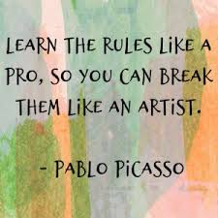

Slide 11
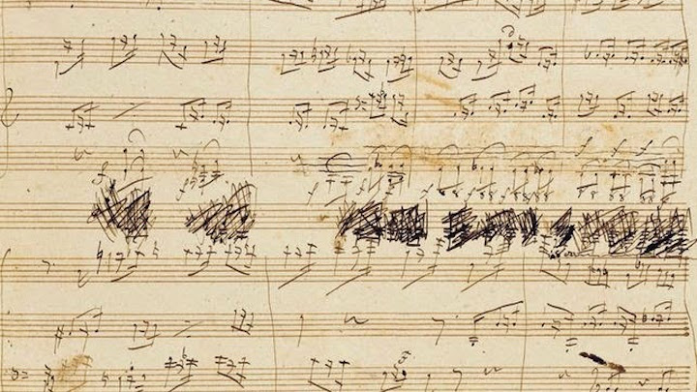
Let’s get started!!
Today we will be learning some basics on Sibelius. Open the program.
We will write the melody to
Beethoven’s “Ode to Joy” for
Bb Trumpet.

