Slide 1
“My Truth is My Identity”
An Approach to Repertoire, Composition, and Music Education from Jodie Blackshaw

Slide 2
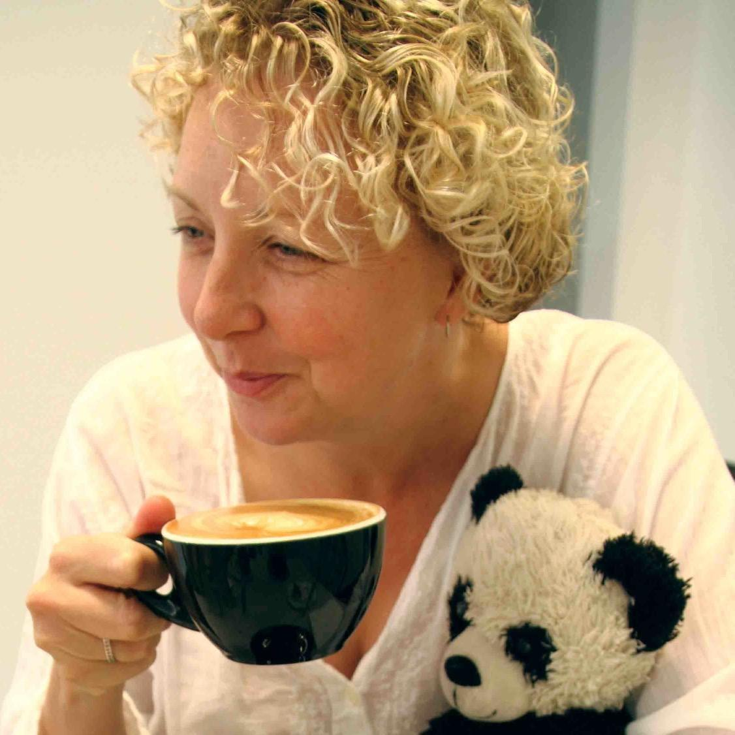
Background
Jodie Blackshaw
Composer-Educator
Taught in New South Wales in a town of seven thousand people called Deniliquin.
Traveled up to 600 miles a week to teach students in remote areas and low income families paid with food, car service, beer at the pub, and home-made chicken soup.
Began by writing music specifically for her students because “she” was too poor to purchase music. She began to write music the way many children first encounter music; without the “laws of music” and not necessarily in a strict time of key signature. This is how her “Student-First” composition style began.
Began master’s degree in composition in 1996 and was met with great resistance from the composition department. Trying to create music for children was not a focus for the department and Mrs. Blackshaw left after 12 months with this reason (and family health issues).

Slide 3
Background
Jodie Blackshaw
Composer-Educator
Mrs. Blackshaw composed with students names mentioned in the music “Celeste’s famous bit”. Did not have part 1/2/3 but rather cricket positions to avoid competition. Regularly wrote in student created melodies with the music.
Bullied at times for centering her repertoire on what will connect her students to music.
Judgement from other came from her choosing a different path and challenged instrumental music norms
Considers herself a blend of Orff-Schulwerk, composer, and conductor. A “Student First” Composer-Educator.
2006 won the Inaugural Ticheli Composition Competition.
2020 earned her PhD in Composition at the Australian National University.

Slide 4
SA NA MA TA
A meditation chant from yoga, that comes from a branch of Indian Sanskrit called Kirtan Kriya (Song-Action).
The “Kundalini” Kirtan Kriya is the Divine Feminine Energy at the base of the spine.
Is it the formless aspect of the Goddess and one of the 4 Chakras.

Slide 5
Breaking Down Prejudicial Barriers
SA - Start with your Students
TA - Remain Current
NA - The Transformation
MA - The Rebirth

Slide 6
Sa
Ta
Beginning and Whole of Existence
Essence of life, existence, and creativity
Start with your students. Learn about the cultural heritage within your student pop.
Slow Down and spend time on teaching about the music and the person who created it. Compositional Approach*
Na
Ma
Change and Transformation
Resurrection, Regeneration, and Rebirth
Intentional choices in choosing music
AND the way is it taught.
Time for (1) Skill (2) Romance (3) Contextualization.
Embrace new ideas. Find inspiration and Broaden perspective.
Orff-Schulwerk, Kodaly, World Drumming, Harmony Bridge, Music Mentors International

Slide 7
Defining Diversity, Diverse Composers, and Diverse Repertoire
Diversity by Country
Australia
State of being diverse; difference; unlikeness
Variety; MultiFormity
Point of difference
U.S.
Condition of being composed of differing elements: variety: inclusion of different types of people (Races/Cultures) in a group/org. Diversity in Schools.
Instance of being composed of differing elements or qualities: an instance of being diverse: a diversity of opinions
French
All the people who differ from one another by their geographic, socio-cultural, or religious origin, their age, sexual orientation, etc., and who constitute the national community to which they belong
Japan (mentions)
Variation, mutation, transition, difference, irregularity, and disorder

Slide 8
Diverse Repertoire
Selecting, rehearsing, and performing repertoire from composers of different races, colors, genders, age, or cultures.
Intentional inclusion of different types of composers (above) in the selection of repertoire for professional ensembles, community/amateur ensembles, university ensembles, primary/secondary school music programs.
Repertoire composed with a variety of elements or qualities; a point of difference; variation; irregular, unconventional.

Slide 9
Diverse Composer
Difference(s) exhibited by race, color, gender, sexuality, ethnicity, religion, age, disability.
Difference(s) exhibited as influenced by their upbringing, socioeconomic situation, education, and geographical location.
Difference(s) exhibited as influenced by their compositional approach.

Slide 10
Repertoire
(R)Evolution
Evolution and Advancement of Repertoire

Slide 11
“It is my hope that in time, there will be no need for terms like diverse repertoire, diverse composer, or intentional programming”
(The Horizon Leans Forward)
The goal is to move from “diverse repertoire, diverse composers, and intentional programming” to a selection of music inherently and purposefully diverse for the benefit of the students. A “Student-First” educational approach.
(J. Blackshaw, personal communication, February 28th, 2021)

Slide 12
Choosing Repertoire
Find music that utilizes elements differently, such as unusual voicings, unique structural ideas, or unconventional rhythmic groupings and alternate harmonic concept.
Find music that embraces melodic fragments or rhythmic elements for the textural variation and timbral nuance.
Find music that has substance; an honest, authentic, voice that expresses something personal, political, or socially topical.
Find music that offers each section opportunities to play parts in different settings, including role and/or function, voicing, and timbral blend.

Slide 13
“FIRST”
Composition Style
The Germinal Idea or Initial Musical Idea
Where the composer takes their source of inspiration
Texture First
Shapiro & Grainger &
Chris Sainsbury
Melody First
Beethoven & Santos
Concept First
Cage Jolley & Hoche &
Opeloge Ah Sam
Rhythm First
Day & Mackey & Reich
What are some others?
Who fits where?
What do you program?
Color First
Y. Nishimura
Harmony First
Bach & Glass
Timbre
Colgrass & Blackshaw

Slide 14
The Impact of the “First” idea
How much is that “First” influenced by your early music experiences, ethnicity, culture, color, gender, or sexuality?
What kind of musician are YOU?
Harmony first?
Melody first?
Color first?
Concept first?
Rhythm first?
Texture first?

Slide 15
“I realized there had been some considerable prejudice against my work because of my compositional approach”
“You can still, today, program a work by a woman or a composer of color and it can all still sound like (formulaic composer), and it means the repertoire isn’t growing, it means were actually not making our repertoire choices about the music, it means were making it for other token-istic reasons. Yes, it’s a great place to start, but don’t stop there”
(J. Blackshaw, personal communication, February 28th, 2021)

Slide 16
Be Kind..
Be Kind to the Planet
Be Kind to Each Other
Listen more Talk Less
Advice to the FSU Band Grads
from Jodie BlackShaw

