Slide 1
Norman Dello Joio
Foundations of Music Education
Notes:
Thomas

Slide 2
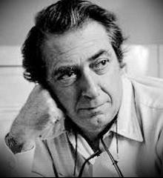
Norman Dello Joio 1913-2008
Composer, Pianist/Organist, and Teacher.
Norman broke the Dello Joios family tradition of being church organists.
As a composer Norman gained international popularity by the 1950’s.
Notable compositions include Meditations on Ecclesiates (Pulitzer) and Scenes from the Louvre (Emmy).
45 choral Works, 25+ orchestral works, 10 band pieces, 25 solo voice, 20 chamber pieces, concertos for piano, flute, and harp, a short clarinet solo, and short harmonica solo.
Dello Joio was an advocate for young composers.
Thomas Bumgardner, Norman Dello Joio (Boston, Massachusetts: Twayne Publishers, 1986), 1-15.
Notes:
Thomas

Slide 3
Background
“Having lived the precarious life of a composer of serious music, I proposed the idea of putting young men of proven talent to work, doing what they should be doing, which was to write music. Since there were school situations in the country that offered outlets, such as choruses, bands, orchestras, and related performing groups, it seemed logical that placing someone in this setting to serve their needs and writing for the particular and specific groups would serve to give young men and outlet, bring to the young students a needed exposure to music of our time, stimulate teachers to expand their, interests in a fresher repertory, and make a general community aware of the fact that composers were living beings, functioning right in their midst.”
In 1957 the Ford Foundation began to explore the relationship between the arts in American Society.
Michael Mark, Contemporary Music Education (London: Prentice Hall International, 1996), 28-29.
Notes:
Phil

Slide 4
The Contemporary Music Project (CMP) Timeline
Chairman of CMP until 1973.
In the late 1950’s Dello Joio and MENC executive secretary came up with a plan to give young composers a chance to share their compositions with Public Schools.
In 1959 the Ford Foundation sponsored the project, then called the Young Composers Project.
12 Composers were placed in schools as composer in residence.
1962 thirty one composers had participated.
Teachers and Students in these programs were more receptive to new music.
Composers could see the benefits for writing in educational settings.
From left to right: George Howerton, chairman, MENC committee on Contemporary Music and member of School Systems Selection Committee; W. McNeil Lowry, program director, Humanities and the Arts, Ford Foundation; Norman Dello Joio; Edward F. D'Arms, associate director, Humanities and the Arts, Ford Foundation; Howard Hanson, president, National Music Council
Michael Mark and Charles Gary, A History of American Music Education (Lanham, Maryland: Rowman and Littlefield Education, 2007), 407-409.
Notes:
Thomas

Slide 5
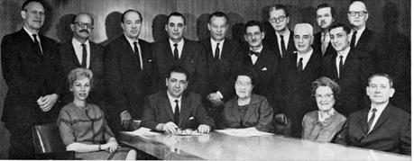
CMP cont…
Because of the success of the Young Composers Project the Ford Foundation made it one of their ten major projects
MENC wanted the project to expand including:
Seminars
Workshops on contemporary music in schools.
Pilot programs in schools.
1963 – Ford Foundation awarded $1.3 million to organize the Contemporary Music Project for Creativity in Music Education (CMP).
The Young Composers Project was continued under CMP.
In 1968 forty-six more composers were placed in schools.
Michael Mark and Charles Gary, A History of American Music Education (Lanham, Maryland: Rowman and Littlefield Education, 2007), 407-409.
Notes:
Ryan

Slide 6
Purpose of the CMP
Increase creativity in music
Increase awareness and acceptance of contemporary compositions
Create a bridge between music education and composition
Increase the quality of contemporary music in public schools
To discover creative talent in students
Contemporary Music Project for Creativity in Music Education, Comprehensive Musicianship: An Anthology of Evolving Thought (Washington: Music Educators National Conference, 1971), 3-4.
Notes:
Phil

Slide 7
Committee of Selection
Made up of two groups:
Composers
Music Educators
The composers were responsible for finding and selecting the young composers.
The music educators were responsible for finding the school.
Norman Dello Joio was chairman of the Committee.
Contemporary Music Project for Creativity in Music Education, Comprehensive Musicianship: An Anthology of Evolving Thought (Washington: Music Educators National Conference, 1971), 3-4.
Notes:
Phil

Slide 8
Projects Summarization
The CMP ended after 14 years in 1973.
The project “gave direction, provided challenges, developed methodology and materials, and made the music education profession more receptive to change and innovation.” (Mark 1986, 35-40)
1964 Dello Joio also participated as a musicologist in the Julliard Repertory Project that collected quality music to be used in teaching kindergarten to sixth grade.
Michael Mark and Charles Gary, A History of American Music Education (Lanham, Maryland: Rowman and Littlefield Education, 2007), 401, 407-409.
Notes:
Thomas

Slide 9
Impact on Music Education
The CMP as well as other 20th century events like the Yale Seminar, Tanglewood Symposium, and Manhattanville program promoted comprehensive musicianship.
Comprehensive musicianship can be defined as developing both musical skill and knowledge as well as synthesizing music materials they use.
The basic philosophy of comprehensive musicianship led to the development of the National Music Standards by MENC.
Charles Norris, “Introducing Creativity in the Ensemble Setting,” Music Educators Journal vol. 97, issue 2 (December 2010): 57-58.
Notes:
Ryan

Slide 10
Impact on Music Ed
In Norman Dello Joio’s own words:
“For a final judgment on what the MENC Contemporary Music Project has meant for music education we will have to wait for the future. But CMP...has suggested a direction for the evolution of music education that I am convinced could have a beneficial effect on schools throughout the United States, and on all levels of education--elementary through postgraduate. The greatest development of individual creativity and the creation of an educational climate in which this creativity--in faculty as well as students--can flourish, has emerged as the principal theme throughout the life of the project. Each of us according to our special talents must concern ourselves with the totality of our musical community-educational and otherwise. It is the insistence on standards and values in this totality that needs our attention whether we are composers or educators, performers or scholars.”
Norman Dello Joio, “MENC's Contemporary Music Project Brought Composers to Classrooms,” Music Educators Journal vol. 70, issue 5 (Janurary 1984): 65-66.
Notes:
Phil

Slide 11
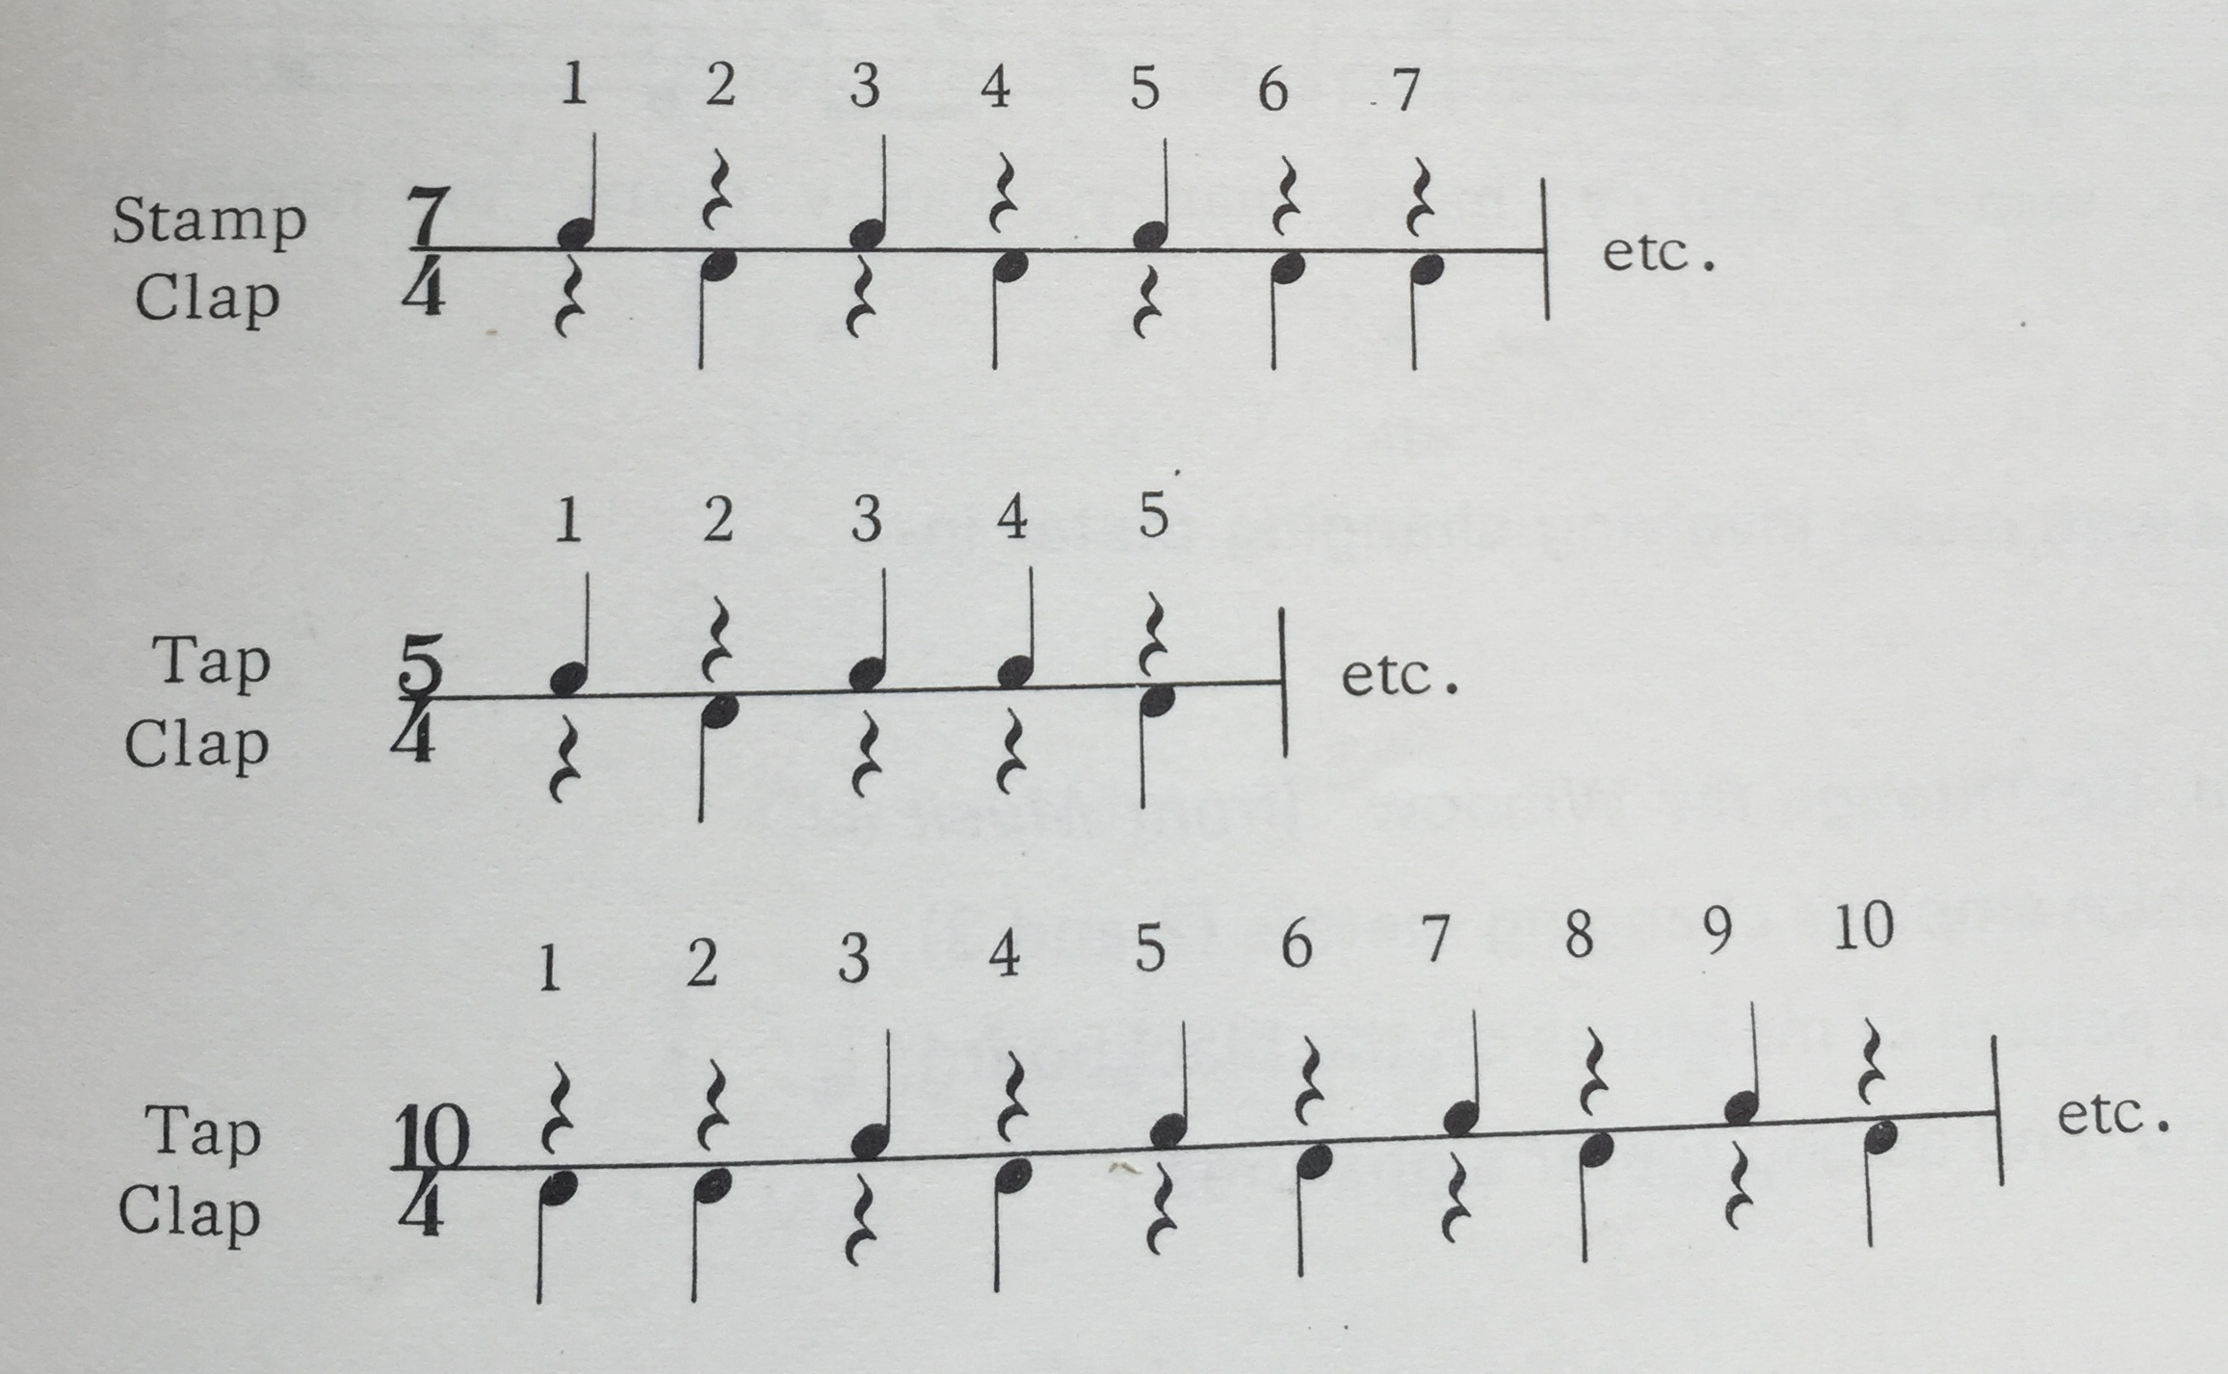
Lesson in Meter and Rhythm
Dave Brubeck - Unsquare Dance
Execise 1
Notes:
Ryan

